Slide 1
Neural Network Implementation from Scratch
Divyansh Pandey

Slide 2
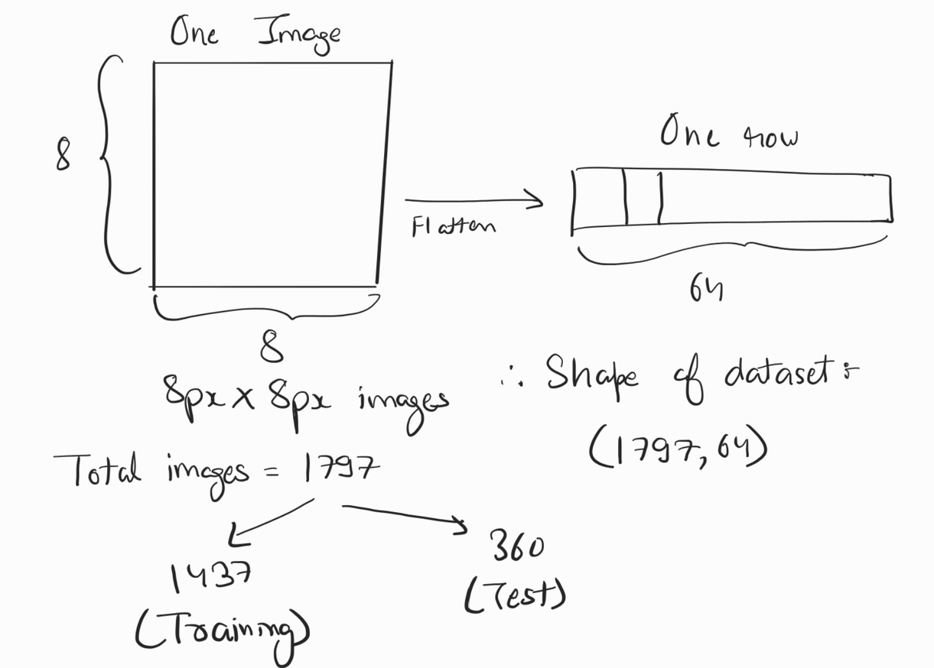
Dataset Structure and Input Shape
sklearn.datasets.load_digits
total images = 1797
With a 80-20 train-test split,
there will be 1437 images
in training set and 360 in test set
Input dims: (1797, 64)

Slide 3
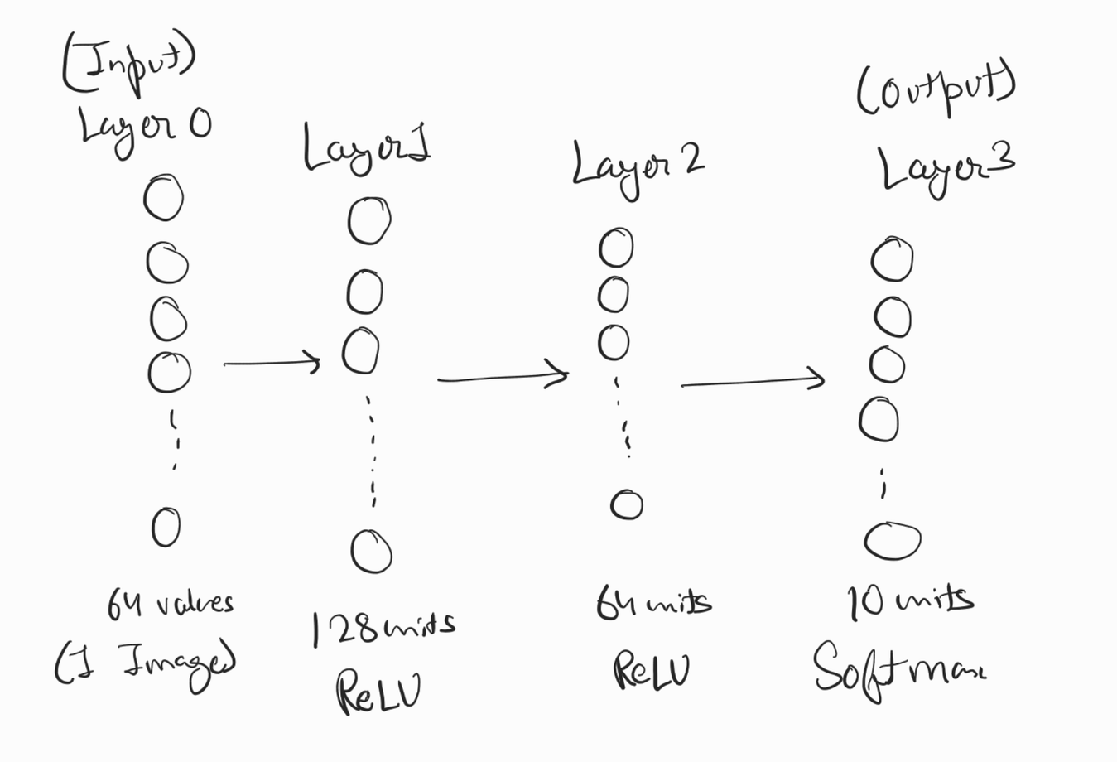
Network Architecture
Input ⟶ 128 ⟶ 64 ⟶ 10
3-layer MLP
Layer 0 ⟶ Input
Layer 1 ⟶ 128 units (ReLU)
Layer 2 ⟶ 64 units (ReLU)
Layer 3 ⟶ 10 units (Softmax)
(Output)

Slide 4
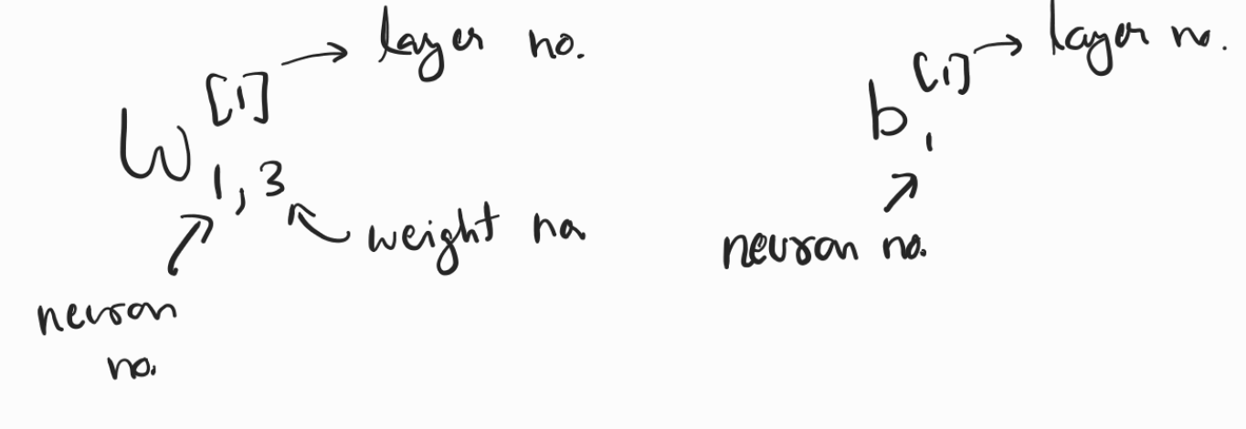
Convention used

Slide 5
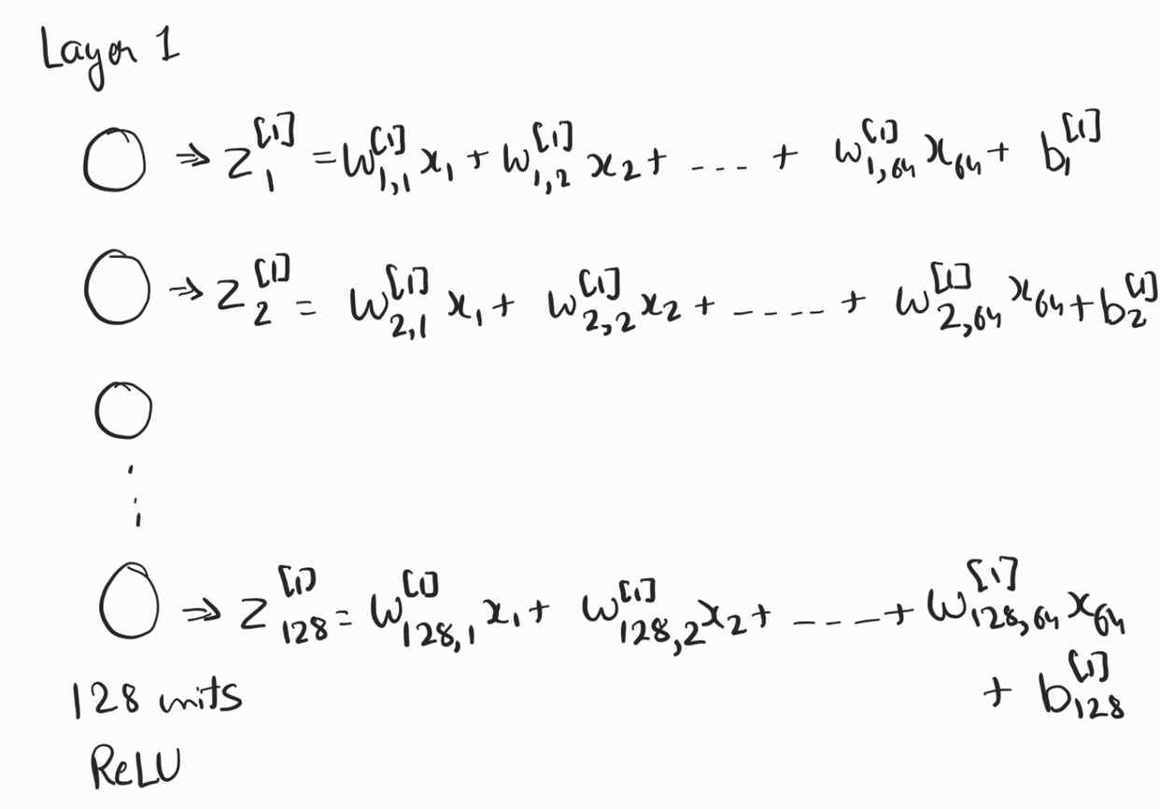
Visualizing Weights and Biases for each unit (neuron)
In the example of Layer 1:
Each neuron gets 64 values
(one image)
all those values are multipled with weights and a bias
is added
The output of each neuron is
represented by z, and the matrix
of all values of z is ‘Z1'

Slide 6
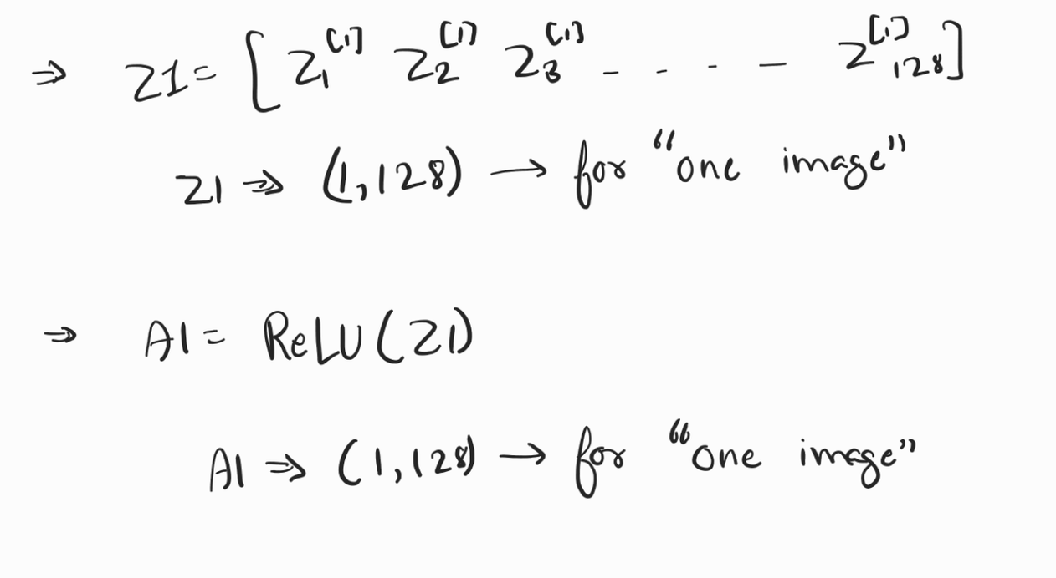
Activation function
In all the hidden layers,
ReLU is used as an activation
function
A1 will act as an activation
for layer 2 and is
calculated as: A1 = ReLU(Z1)
Since ReLU performs
element-wise operation, the
dimension of matrix do not change

Slide 7
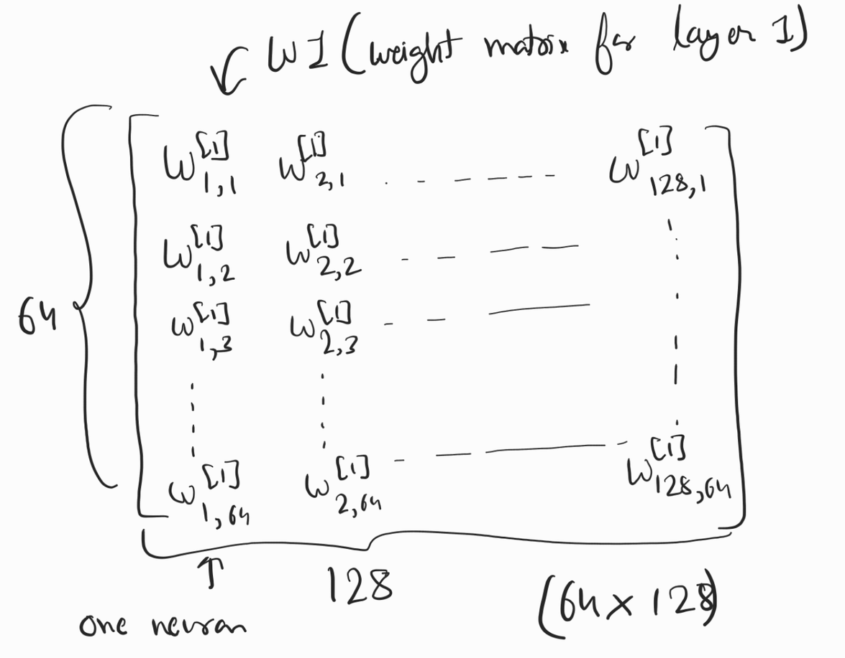
Dimension of Weight matrices
The image on the right shows the
weight matrix w1(for layer 1)
In this matrix, each column
represents weights of one neuron
in layer 1. The number in superscript
is the layer number and first number
in subscript represents neuron
number in one layer.
Dims of w1 ⟶ (64, 128)

Slide 8
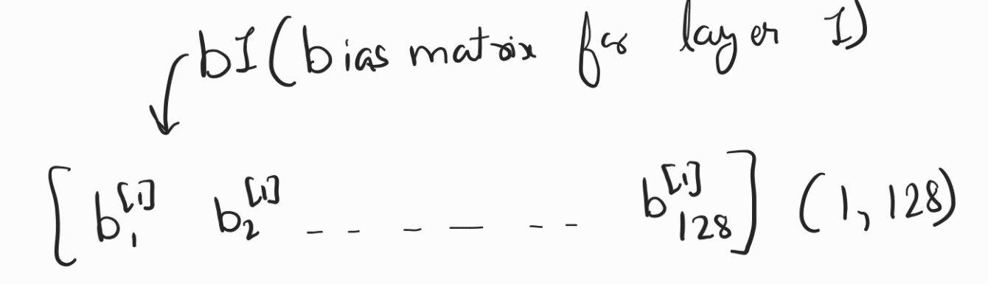
Dimension of Bias Matrices
Dims of b1 ⟶ (1, 128)
Following the same notation, here too each column of the matrix is the bias
value of one neuron and the number in subscript is the neuron number while
the number in superscript is the layer number.

Slide 9
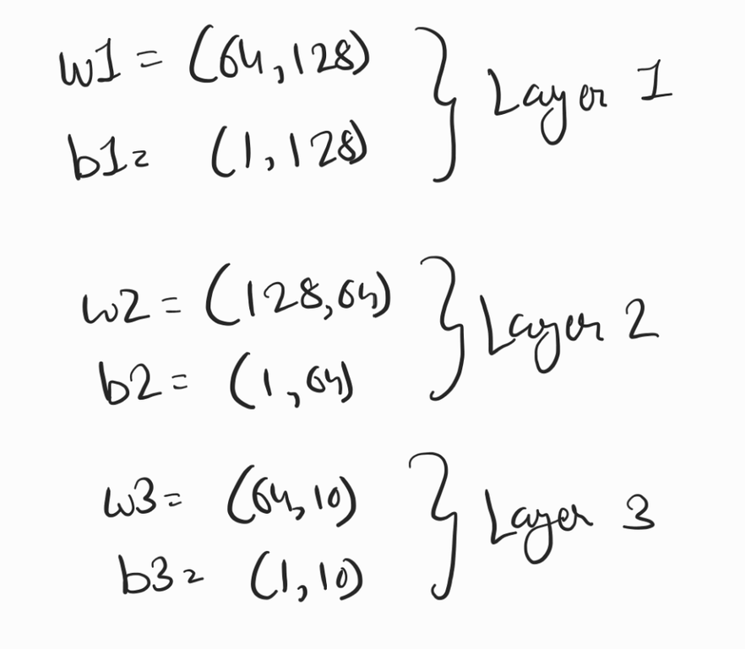
Dimension of weights and bias matrix in each layer
Weights and bias matrix could be found
by following the trends in the last two
slides.
One observable point is that for every
  Weight matrix ⟶ (n_in, n_out)
  Bias matrix ⟶ (1, n_out)
where n_in = number of inputs for layer (or)
number of neurons in previous layer
n_out = number of outputs by layer (or)
number of neurons in current layer

Slide 10
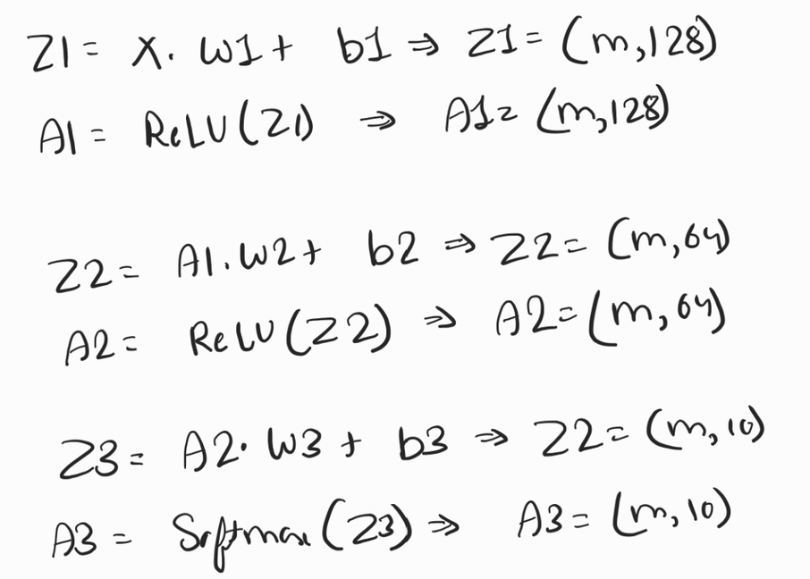
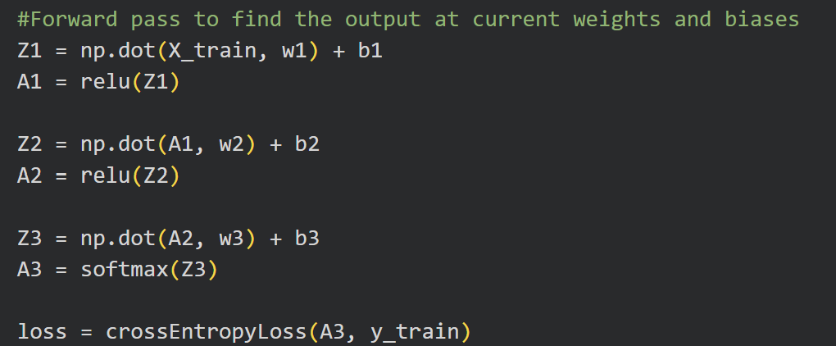
Forward pass
In forward pass, we move towards output
from the input.
The code below shows the implementation of
forward pass. Forward pass is used to do the
actual prediction by the network once you train it.
In easy words, training is actually
finding the right value of weights
and biases which give the
expected output for an input
in the neural network.

Slide 11
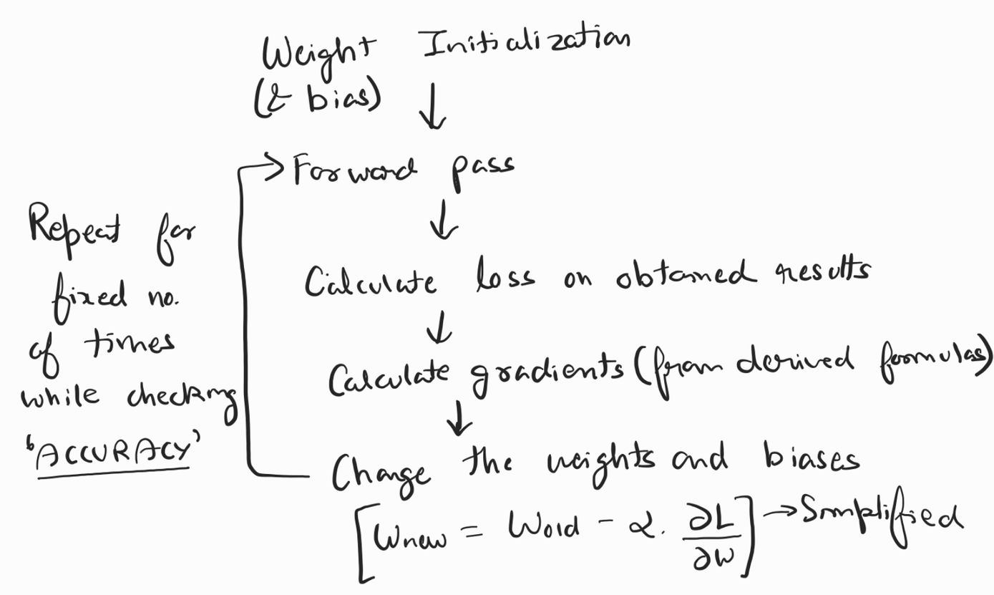
Backward pass
Backward pass, as the name suggests, is moving from output towards input.
We first find the output the
network is giving by doing a
forward pass for initialized
weights.
After that we calculate loss for
that output, it is like comparing
the current output with actual
label to find out how far we are
from real value and move
towards it.

Slide 12
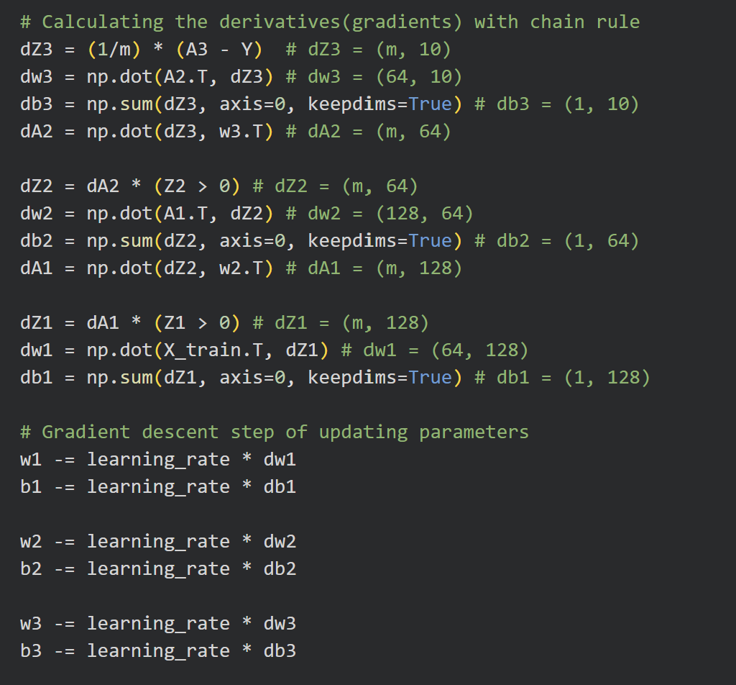
After calculating the loss, we have to
determine how to change weights(and
biases) to get the loss to decrease.
For this, we find the derivative of loss
with respect to weights(w1, w2, w3) and
biases(b1, b2, b3) and apply gradient
descent.
By definition derivative is the change of
one quantity w.r.t another and our goal
it to find that wheather decreasing or
increasing a particular parameter is
going to increase or decrease the loss.
Then we apply standard gradient descent to change the parameters accordingly.

Slide 13
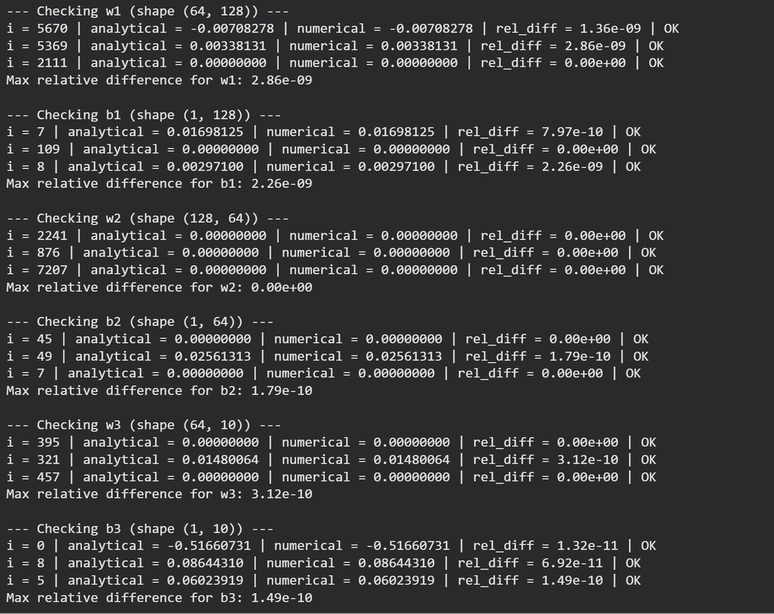
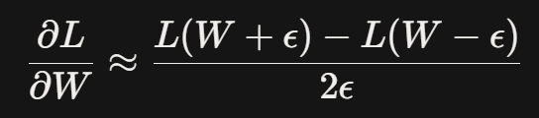
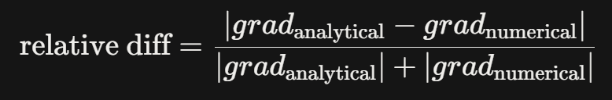
Gradient Checking
The gradient checking is done by
calculating gradient for a few weights and
biases in two ways and then comparing
their relative difference:
At first, the gradient was calculated by
first principle method with the formula
below.
Secondly, with the formulas for different
gradients we derived, if these two give
very less relative diff, of order 1e-7, then we can assume that our gradients are correct.

Slide 14
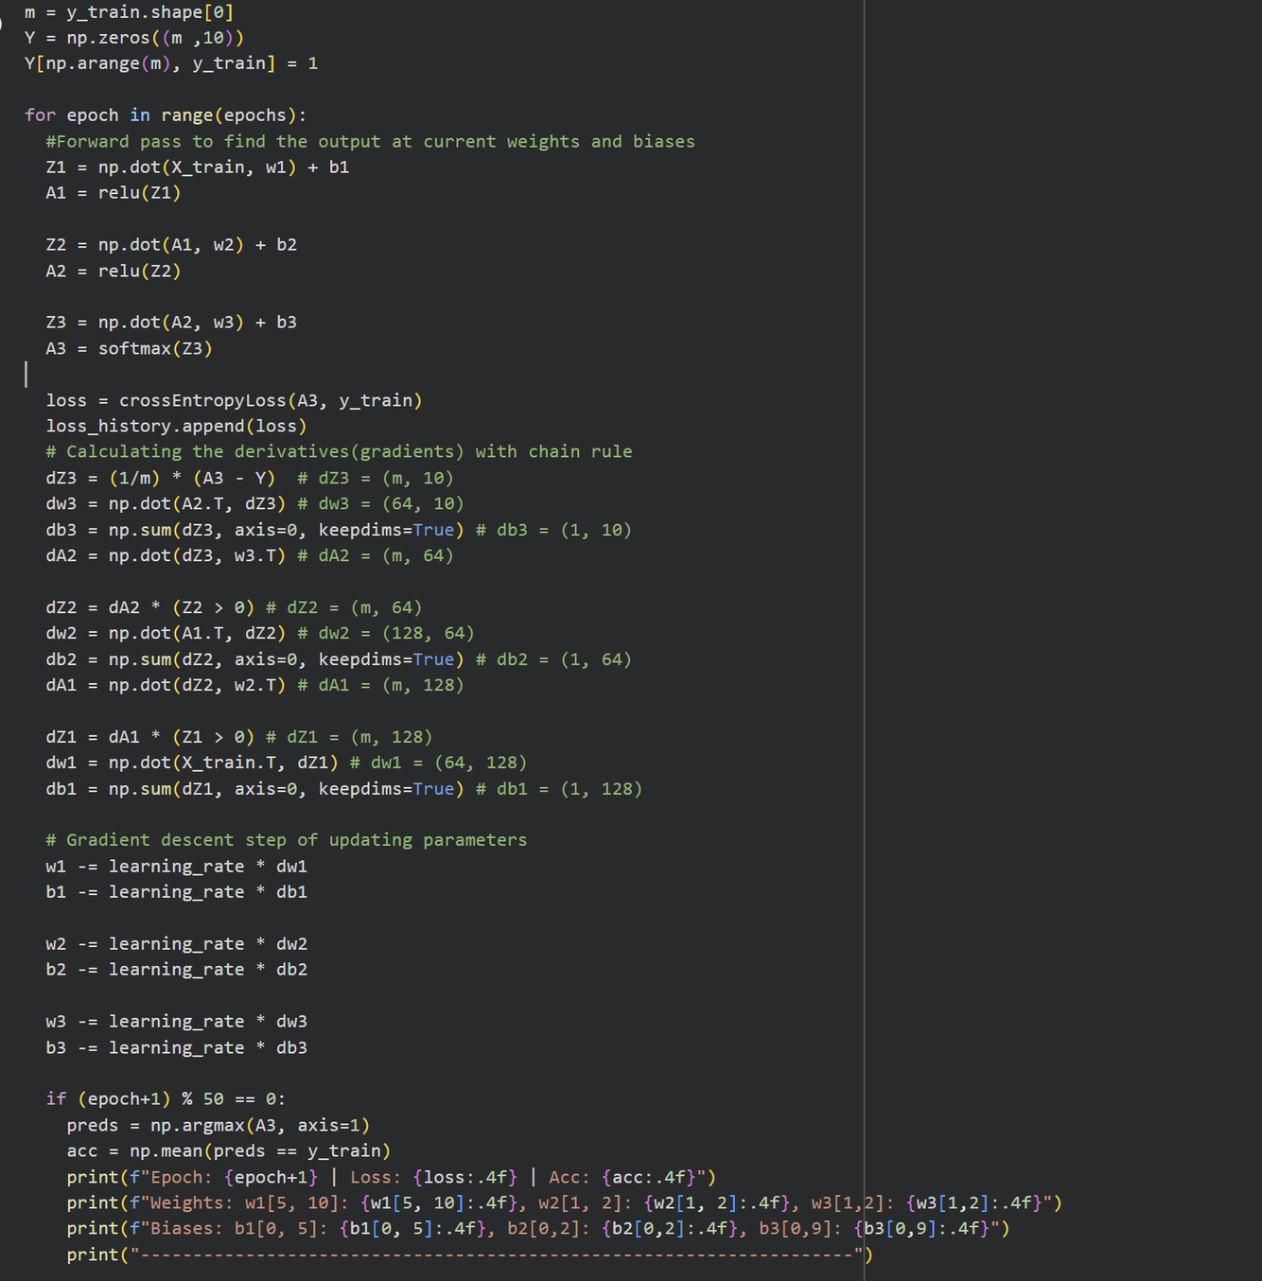
Training Loop
The training loop is nothing but
combining this forward pass, loss
calculation and backward pass, while
keeping check on accuracy and loss.
The training loop is executed many
times, predefined in the code as
‘epochs’.
The learning rate is also pre-defined
and set to 0.1. Changing epochs and
learning rate affects the time taken
and quality of training of model.

Slide 15
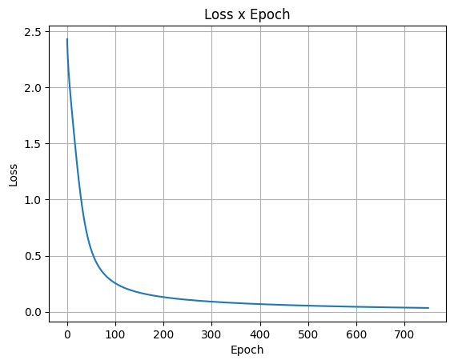
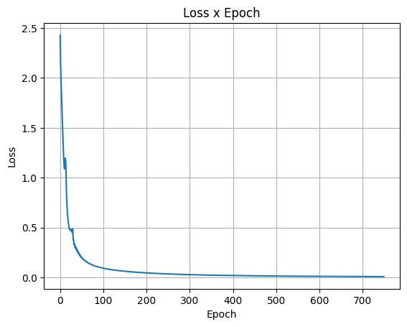
Loss curve at learning_rate = 0.1
(this one is used)
(slow convergence)
Loss curve at learning_rate = 0.3
(moderate convergence)

Slide 16
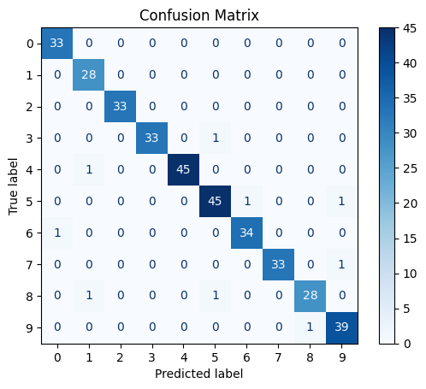
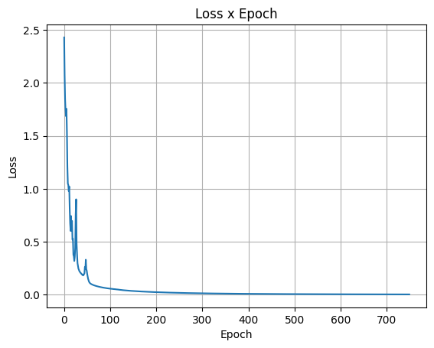
Confusion Matrix
for 97.5% accuracy
on scratch implementation
Loss curve at learning_Rate = 0.5
(faster convergence)

Slide 17
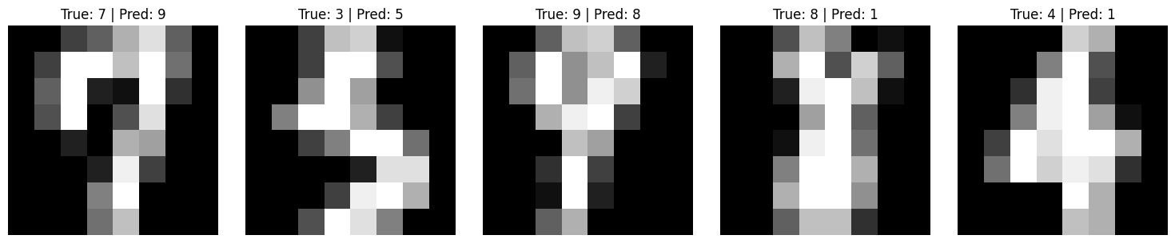
Misclassified images
The images that were misclassified by the model contain ambiguity as we can
see in the images themselves, as a ‘7’ with a curve that goes too down can
confuse to model to assume that it’s a ‘9’. Similar ambiguity can be seen in other
images. This shows that our model is working good on normal images.

Slide 18
Scratch Implementaion
Framework Implementation
Max accuracy: 98.0556 %
Most of the time: ~97.5%
Max accuracy: 98.33%
Most of the time: ~97.78%
More lines of code
2 to 3 times less line of code
No optimization untill self-
implemented from scratch
Automatic optimization in many ways,
in training, in data handling, in calculation, etc.
Less memory efficient.
More memory efficient because of optimized code and implementation
This implementation is made for only
this type of model, with crossentropy
loss, relu and softmax activation.
Works for all types of activation and
loss function with better options.

Slide 19
THANK YOU !
The framework didn't do anything conceptually different — it automated
the exact same chain-rule computations, which is why doing it by hand first made the framework version make sense rather than feel like magic.
~Some LLM

